Slide 1
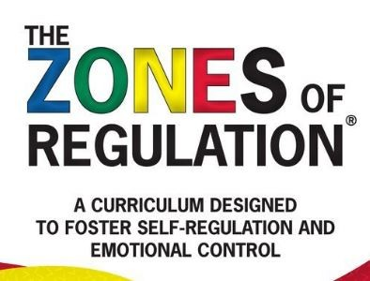

Slide 2
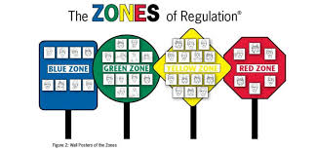
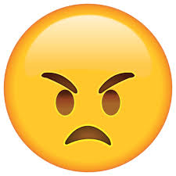
What Are Zones of Regulation?
They’re a bit like the traffic lights that you are using at moment.
They help us to:
Tell people how we feel when we don’t have the words for our emotions;
Help us to understand how much energy we should have in a given situation;
Help us to find ways to change how much energy we have: so we might feel more or less fizzy and energetic.

Slide 3
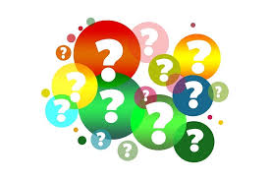
Guess The Zones
See if you can guess what the four zones might be?
Clue: think of your traffic light system

Slide 4
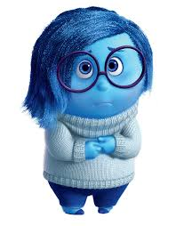
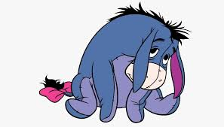
Blue Zone
Your body is running slow.
You don’t have much energy.
You might feel tired, sick, sad, bored or relaxed.
It’s good to be blue when:
You’re going to bed;
Reading a book;
Having a bath.

Slide 5
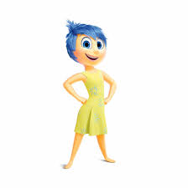
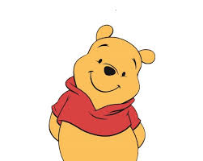
Green Zone
Like a green light, you are “good to go.”
You body may feel happy, calm and focused.
It’s good to be green when:
You’re doing your learning;
Eating your tea;
Chatting with your friends.

Slide 6
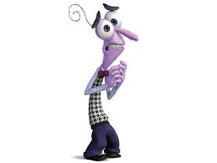
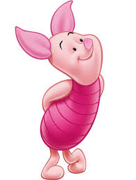
Yellow Zone
You’re body is on high alert and feels fizzy.
You might feel frustrated, anxious, worried, silly or surprised.
Use caution when you are in this zone.
It’s good to be yellow when:
You’re playing sport;
It’s break time;
You’re getting ready to do an exam.

Slide 7
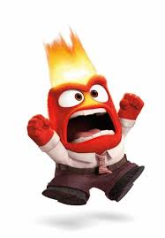
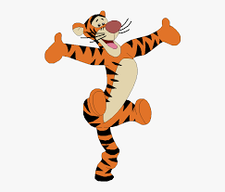
Red Zone
You might feel anger, shouting and over elation.
You might be out of control.
You’ll have trouble making good decisions and
should STOP!
Sometimes we all feel in the red zone and that’s okay but we need to try to get back to green.
You could take deep breaths, or go for a walk.

Slide 8
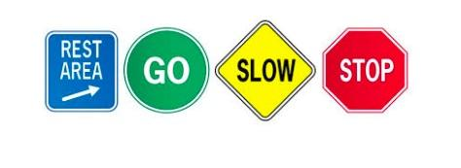
What Next?
You can use the Zones to tell adults in school how you feel.
Adults in school will talk about Zones when referring to learning activities and to ask you how you are feeling/
Don’t worry if you can’t remember what each Zone means, there will be visuals to help you to remember and to help you tell people about your Zone.

Slide 9
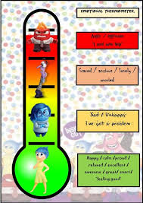
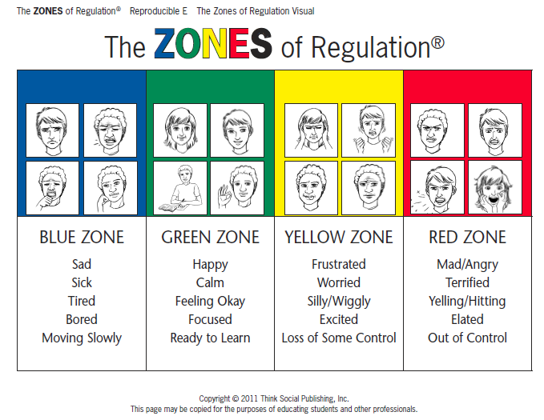
You Might Start To See

Slide 10
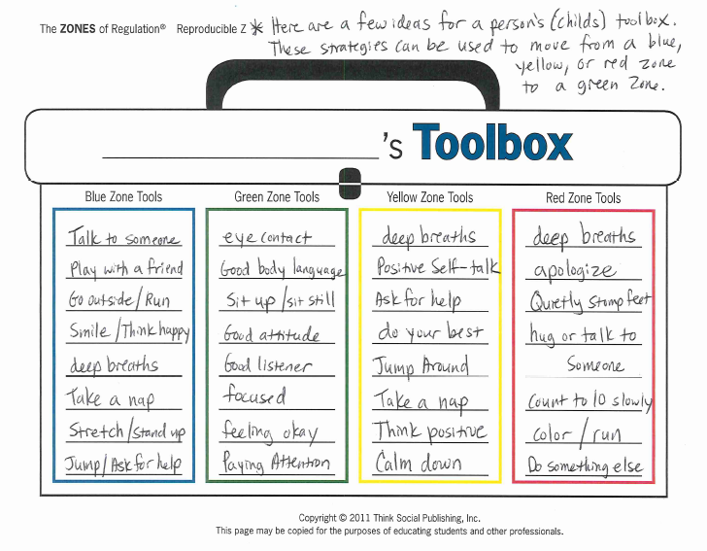
What Next?
Adults in school might start to to talk to you about what you can do to change Zones - these activities are called your toolkit.

